Slide 1


INT201 Decision, Computation and Language
Lecture 12 – Review Dr Chunchuan Lyu

Slide 2
Summary of Summary
What can machines do and can not do?
Regular Languages Regular Expression
Deterministic Finite Automata (DFA) Nondeterministic Finite Automata (NFA)
Context Free Languages
Nondeterministic Push-down Automata (PDA)
Turing-Decidable Languages
Turing Machine that Always Halts (Decider)
Turing-Recognizable Languages
Turing Machine
All Languages
Nothing that we can enumerate

Slide 3
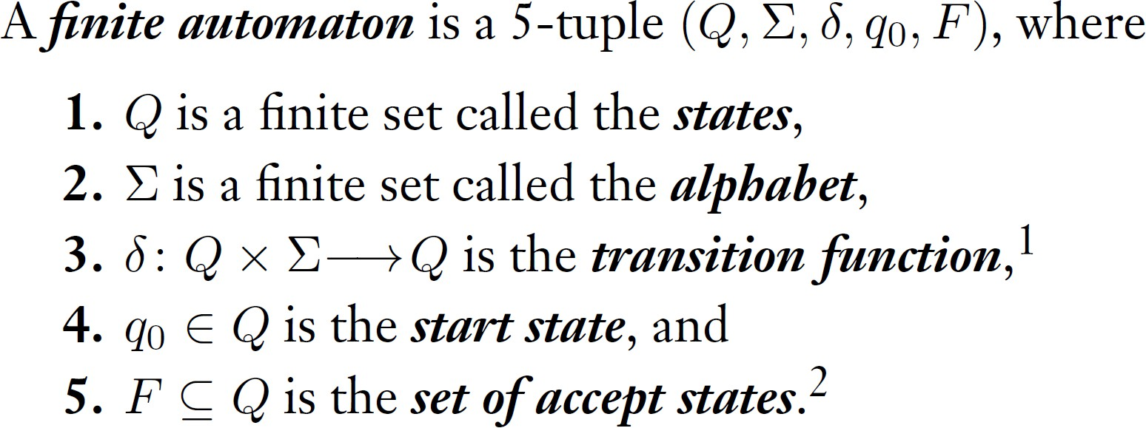
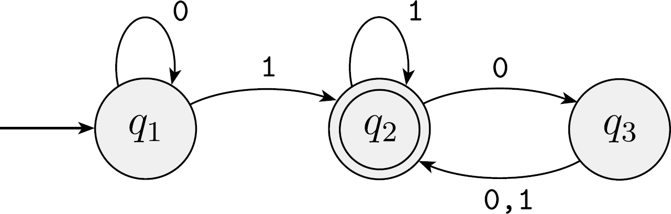
Deterministic Finite Automata and Regular Language
If A is the set of all strings that machine M accepts, we say that A is the language of machine M and write L(M) = A.
A language is called a regular language if some finite automaton
recognizes it.

Slide 4
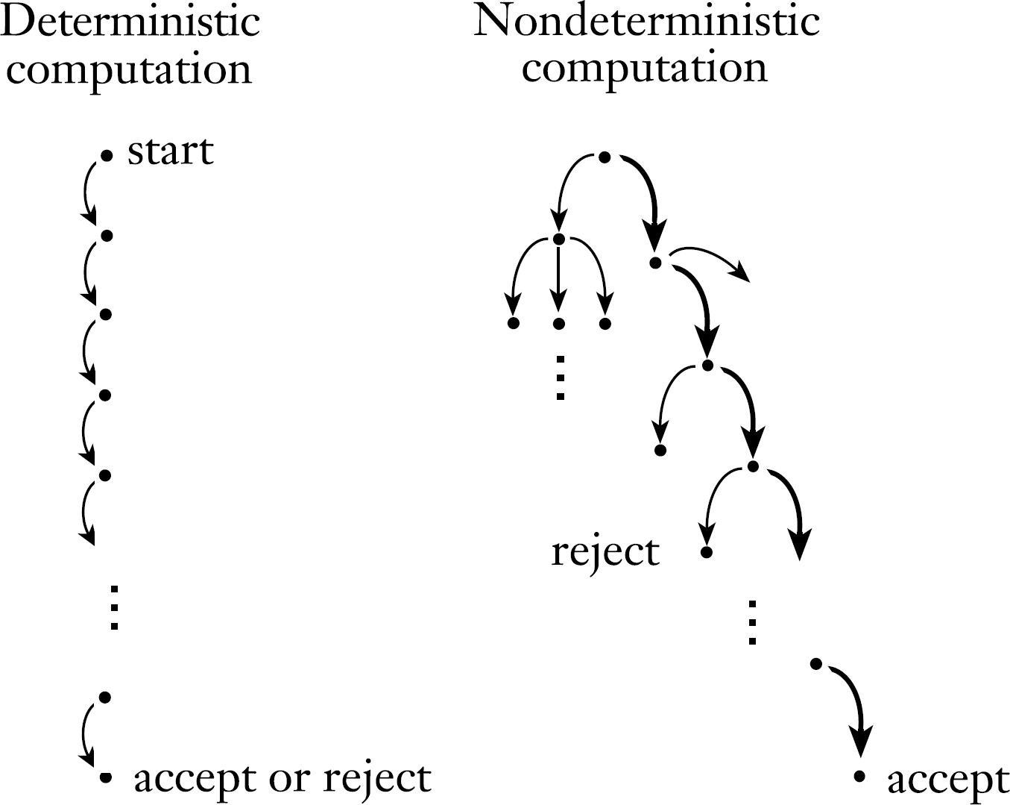

Nondeterministic Finite Automata
Accept as long as one branch can accept the string

Slide 5
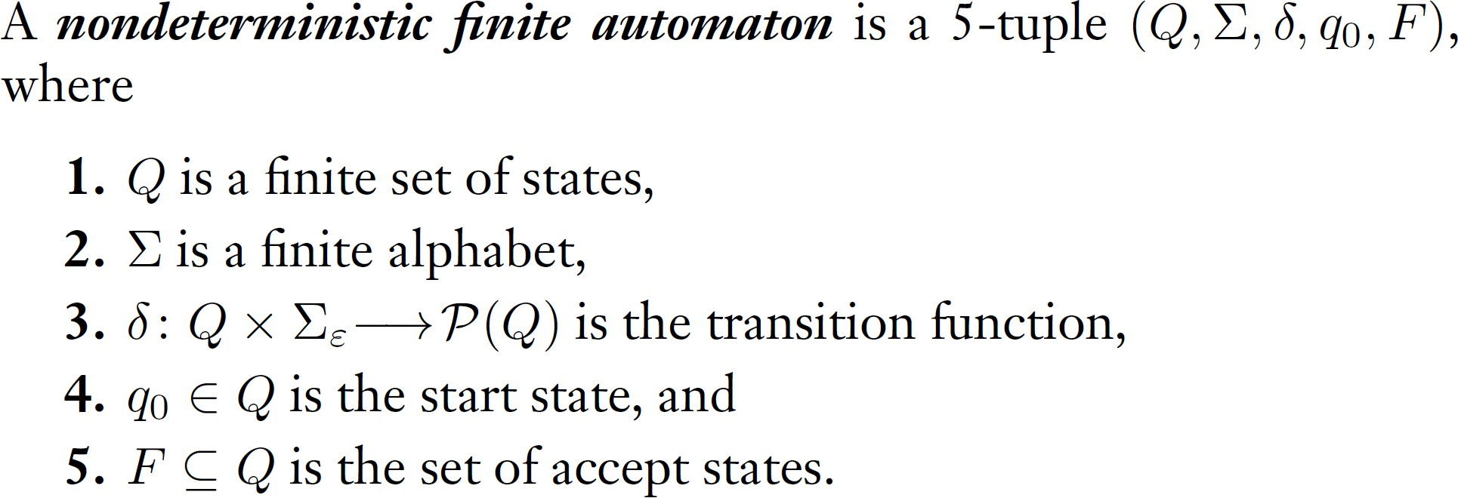
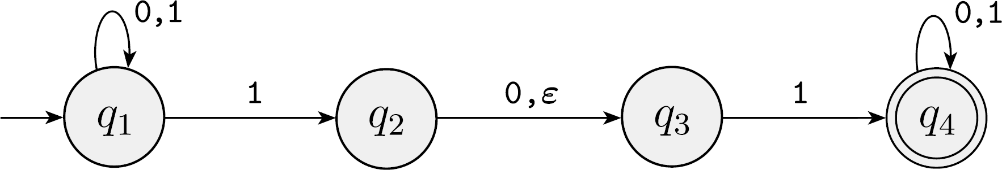
Nondeterministic Finite Automata
Multiple transition in the same state for the same string, defined by transition function has range in the power set.

Slide 6
Nondeterministic Finite Automata
Theorem:
Every nondeterministic finite automaton has an equivalent deterministic finite automaton.
Proof idea:
Construct DFA with states corresponds to the sets of states in NFA.

Slide 7
Regular Language Closure Properties
Theorem
The class of regular languages is closed under the complement, union, intersection, concatenation, and Kleene star operation.
Prove by constructing a new DFA/NFA to accept the language or relying on proven closure property.

Slide 8
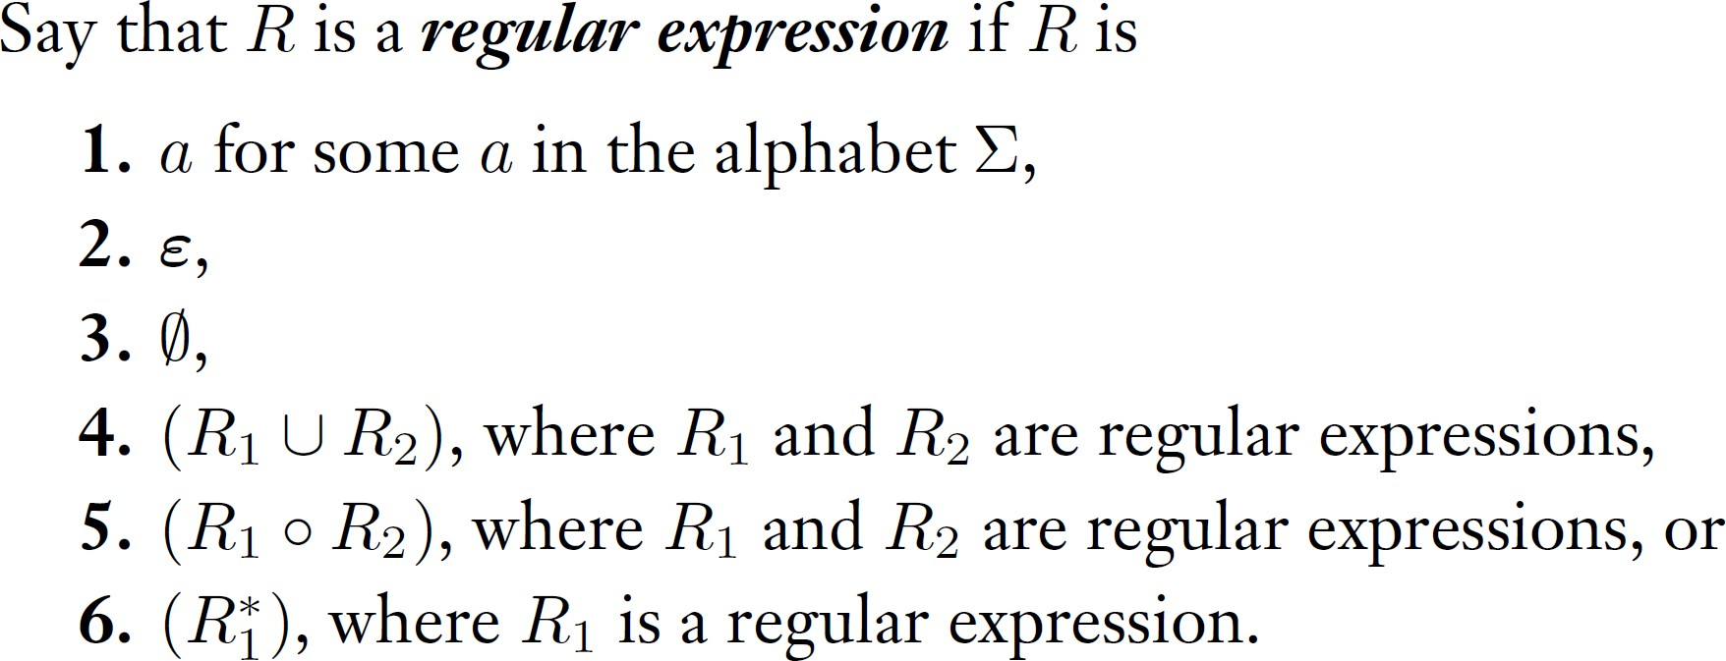
Regular Expression
Theorem
A language is regular if and only if some regular expression describes it.
Proof idea:
Build NFA through its’ closure property and build RE from generalized NFA whose transitions are REs.

Slide 9
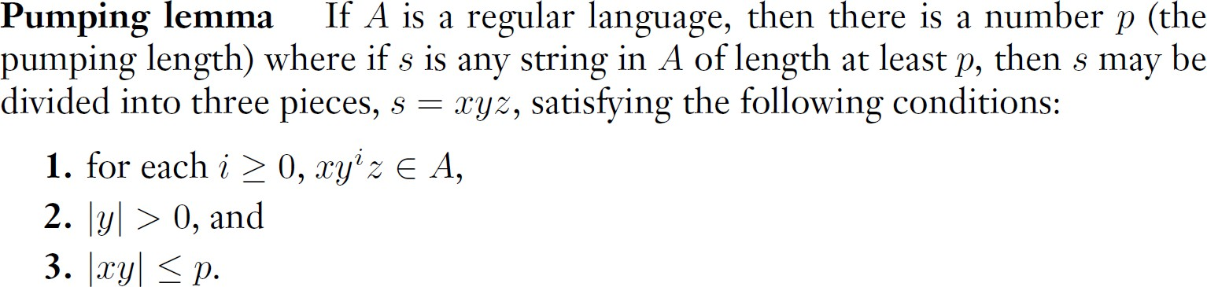
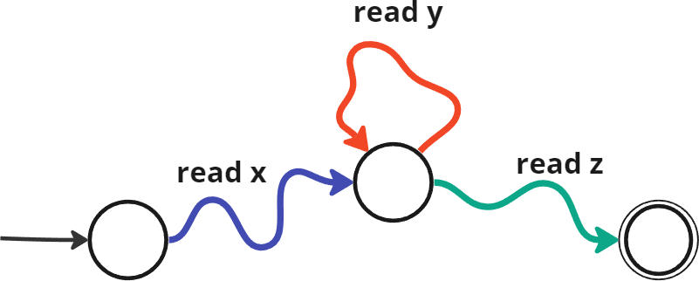
Regular Language Pumping Lemma
Proof idea:
DFA cannot recognize arbitrary long strings without repeating its state.
Application:
{0^{𝑛}1^{𝑛}|𝑛 ≥ 0} is non regular.

Slide 10
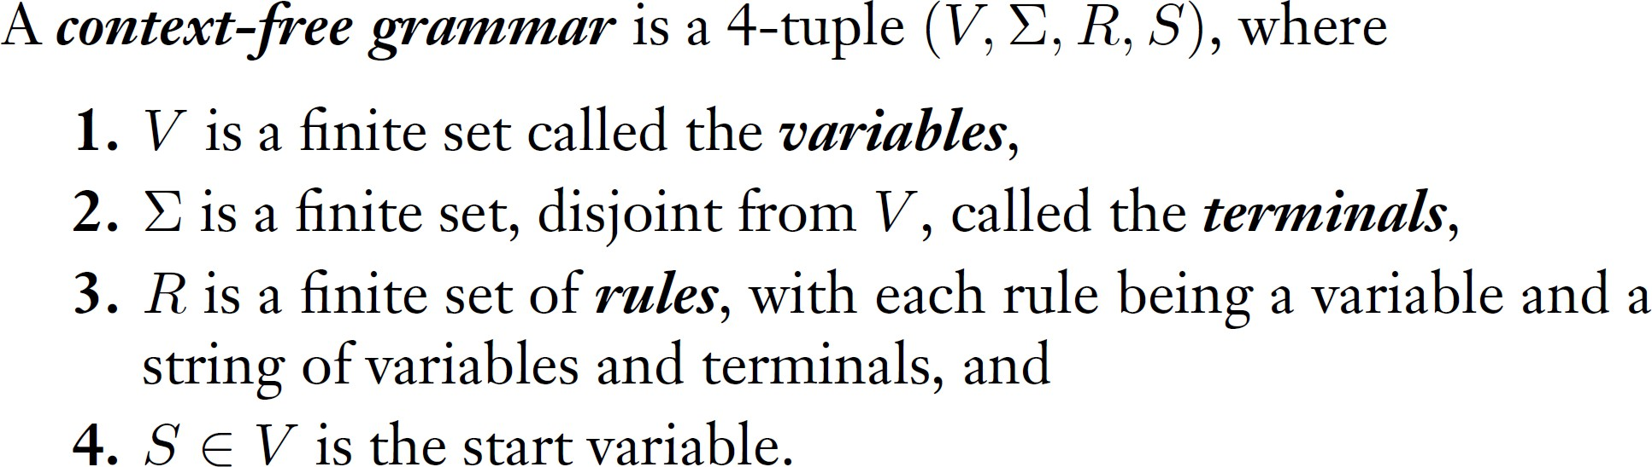
Context-free Language
Example:
G= ({S},{0,1},{S → 0S1 | ε}, S)
L(G)= {0^{𝑛}1^{𝑛}|𝑛 ≥ 0}

Slide 11
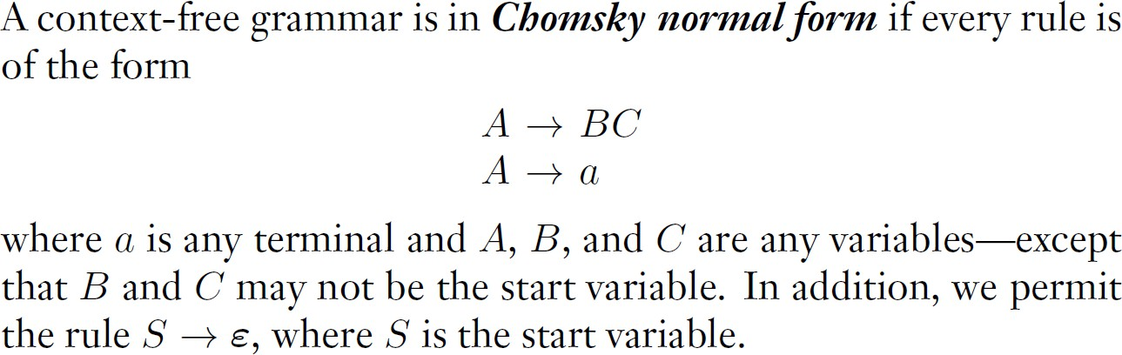
Chomsky Normal Form
All variable generate two non-start variables or a terminal symbol. Only start variable generates empty string.
CNF ruled out unnecessary production rules and constrained the derivation search pace.

Slide 12
Chomsky Normal Form is Sufficient
Theorem
Any context-free language is generated by a context-free grammar in Chomsky normal form.
Proof idea:
Non start variables that generate empty string can be avoided in the first place. Long production rules can be decomposed.
Unary production rules can be eliminated.

Slide 13
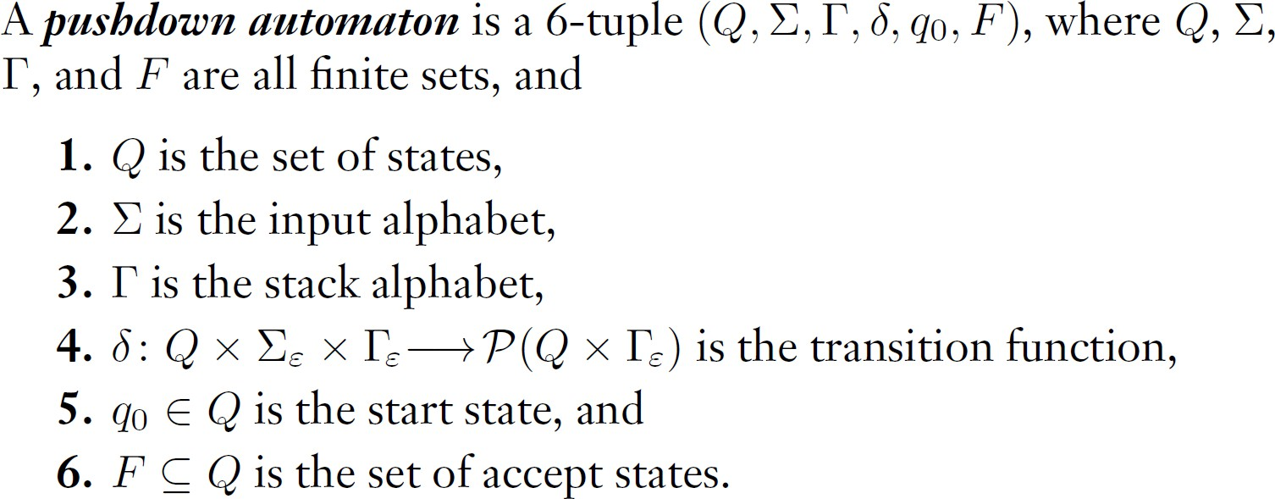
Pushdown Automata
(Standard) PDA is non-deterministic. They are NFA with a stack. Deterministic PDA is weaker than PDA.

Slide 14
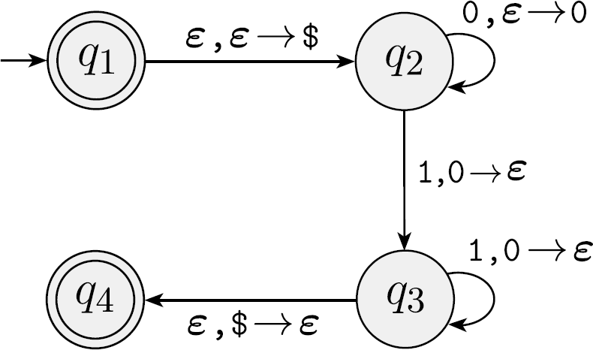
Pushdown Automata
𝐿 𝑀 = {0^{𝑛}1^{𝑛}|𝑛 ≥ 0}

Slide 15
Pushdown Automata and CFG are equivalent
Theorem
A language is context free if and only if some pushdown automaton recognizes it.
Proof idea:
PDA simulate CNF by replacing symbols on the stack.
All PDA can be simplified so that they start and ends with empty stack, have a unique accepting state and have simple transitions.
CFG production rules can cover all states to states transitions that did not look at the stack context.

Slide 16
Context Free Language Closure Properties
Theorem
The class of context free languages is closed under the union, concatenation, and Kleene star operation.
Proof idea:
Easy to see from the PDA perspective.

Slide 17
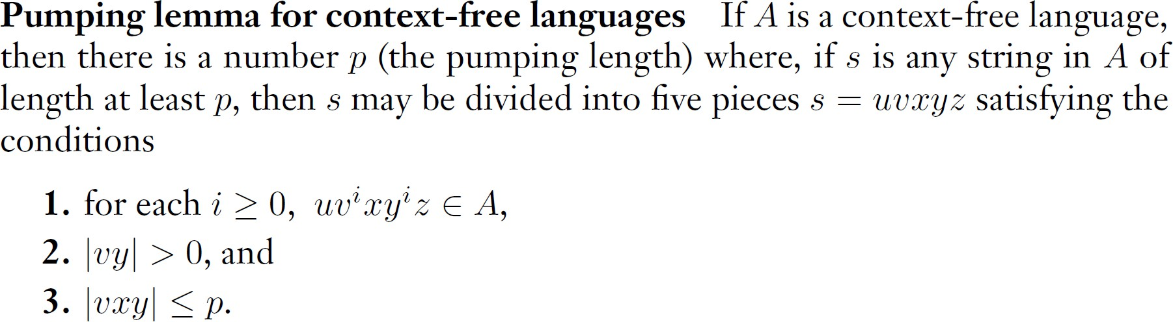
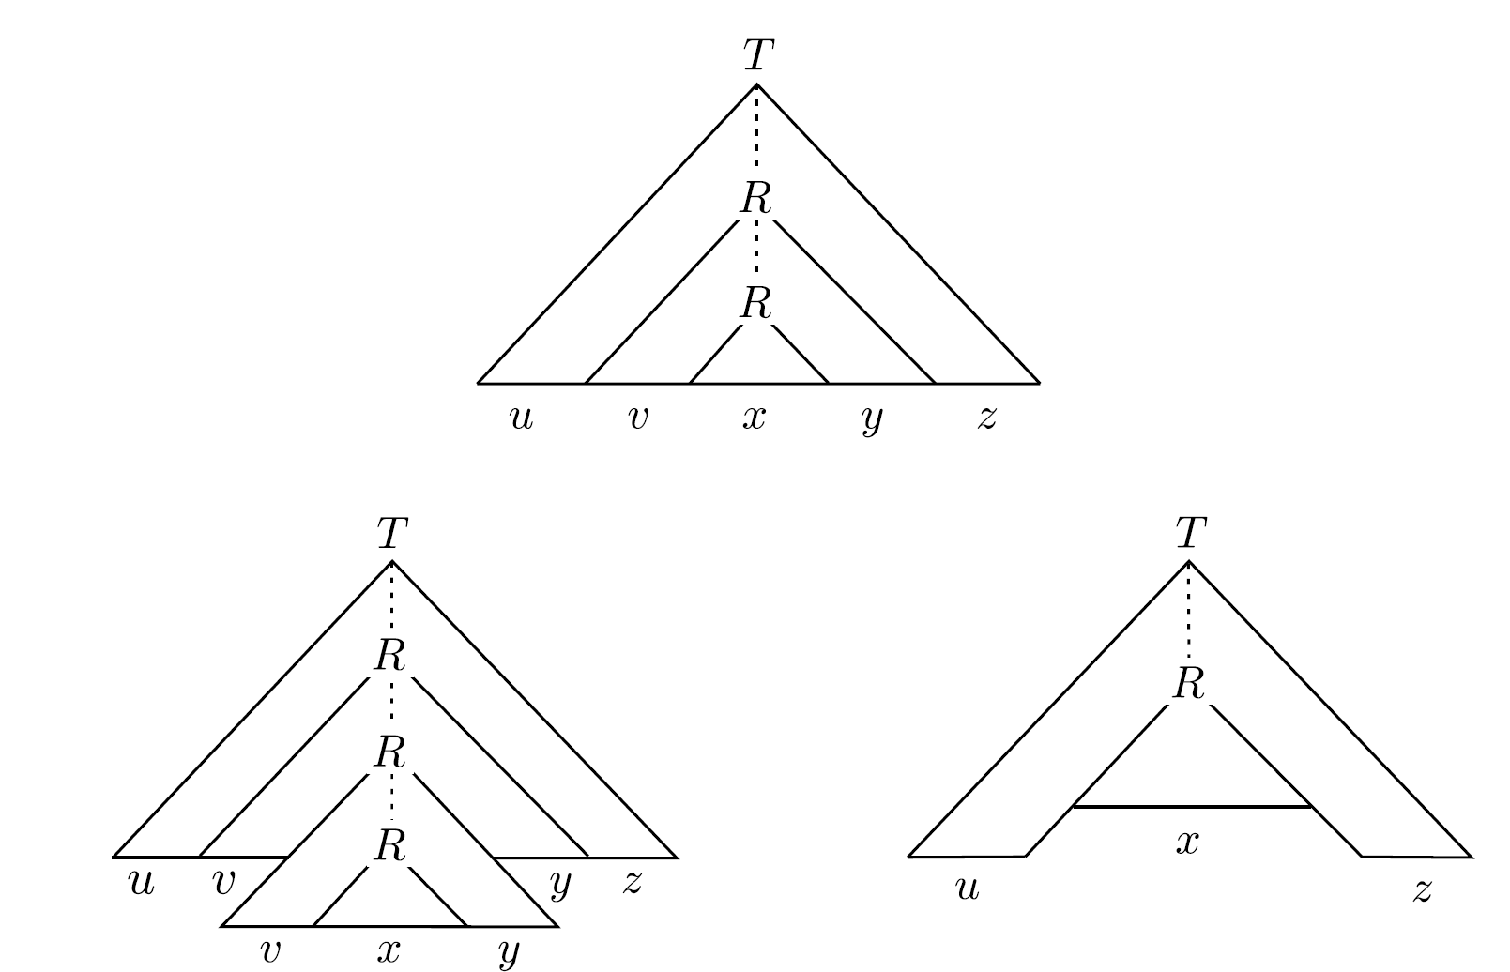
Pumping Lemma for Context Free Language
Proof idea:
CFG cannot generate arbitrary long strings without repeating its variable.
Application:
{𝑤𝑤|𝑤 ∈ 0,1 ∗} is non context free.

Slide 18
Take time to fill the MQ

Slide 19
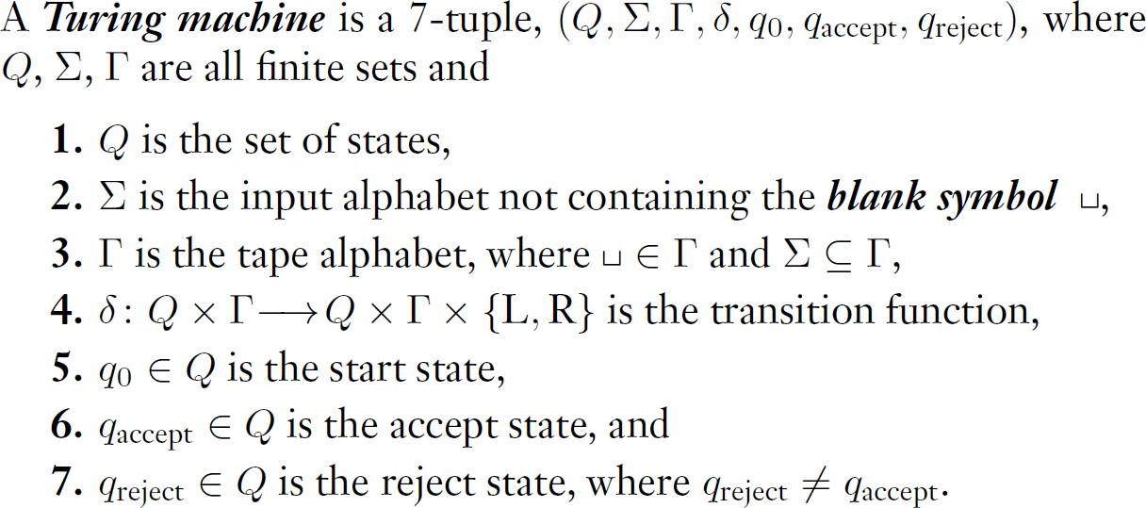
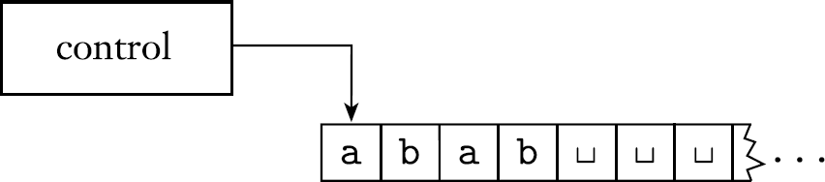
Turing Machine
They are DFA with a writable infinite tape.
Accepts or rejects once it is in accept state or reject state.

Slide 20
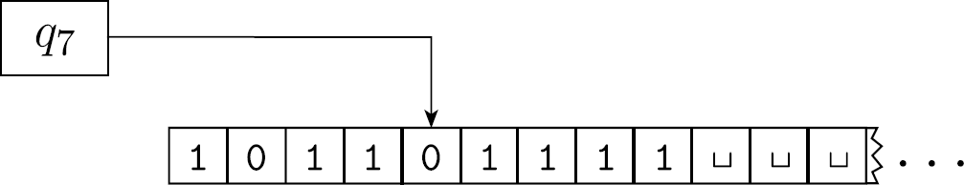
Turing Machine Configuration
A Turing machine M accepts input w if a sequence of configurations 𝐶₁, 𝐶₂, . . . , 𝐶_{𝑘}exists, where
𝐶₁ is the start configuration of M on input w,
each 𝐶_{𝑡} yields 𝐶_{𝑡+1}, and
𝐶_{𝑘} is an accepting configuration.
A Turing machine with configuration 1011𝑞₇01111
𝛿𝛿(𝑞_{𝑖}, 𝑏) = (𝑞_{𝑗𝑗} , 𝑐, 𝐿) gives
C_{t} = 𝑢𝑎𝑞_{𝑖}𝑏𝑣 yields C_{t+1} = 𝑢𝑞_{𝑗𝑗}𝑎𝑐𝑣

Slide 21
Recognizable Language and Decidable Language
Call a language A Turing-recognizable if some Turing machine M recognizes it in the sense that ∀𝑤 ∈ Σ∗, 𝑤 ∈ 𝐴 if and only if M accepts w.
Call a language A Turing-decidable if some Turing machine (decider) M decides it in the sense that ∀𝑤 ∈ Σ∗, if 𝑤 ∈ 𝐴 , M accepts w, and if 𝑤 ∉ 𝐴 , M rejects it.
Clearly, all decidable languages are recognizable.

Slide 22
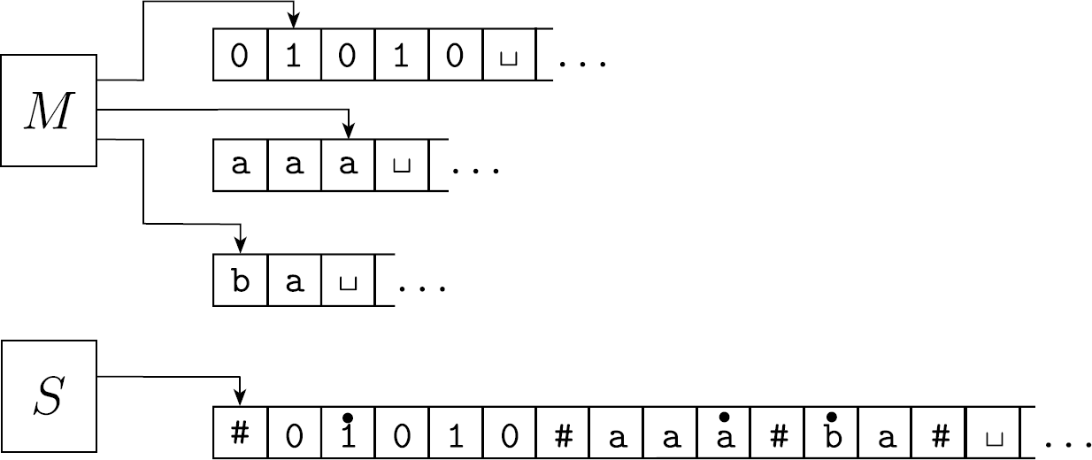
Multi-Tape Turing Machine
Theorem
Every multi-tape Turing machine has an equivalent single-tape Turing machine.
Proof idea:

Slide 23
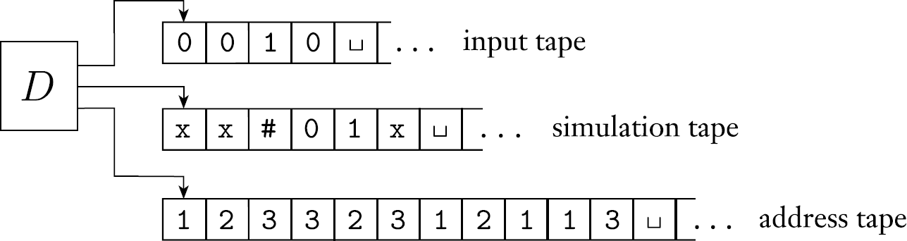
Nondeterministic Turing Machine
Theorem
Every nondeterministic Turing machine has an equivalent deterministic Turing machine.
Proof idea:
Check all branches of NTM through BFS over computation history recorded in the address tape.

Slide 24
Existence of Non-Turing Recognizable Languages
Theorem
There exists non Turing-recognizable languages.
Proof:
There are uncountable many languages, but countable many Turing machines.

Slide 25
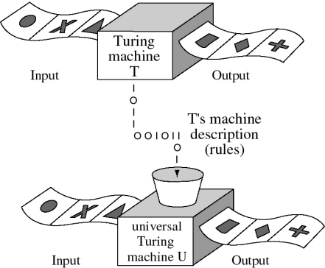
Universal Turing Machines
Theorem
There exists a TM U that takes a Turing machine description and input tape and simulate one step of that given Turing machine on the input tape.
Proof idea:
TM can simulate modern computer, following TM descriptions are purely mechanical.

Slide 26
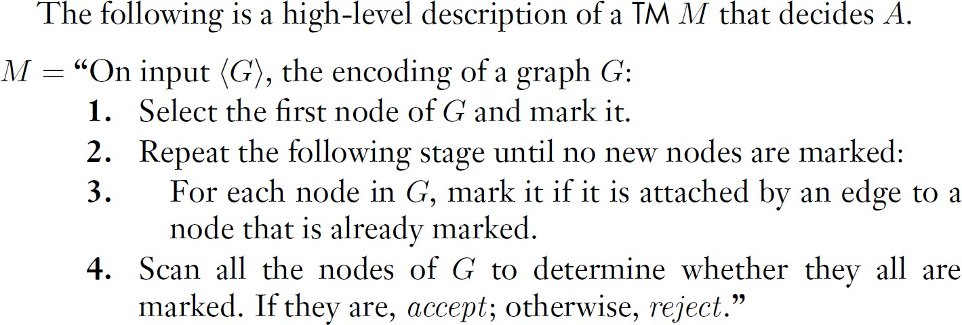
Turing Machines High Level Description
A = {<G>| G is a connected undirected graph}.
TM can perform computation on high level data structure that modern computers can perform.
In reality everything is encoded in binary after all.

Slide 27
Turing Language Closure Properties
Theorem
The class of Turing recognizable languages is closed under ?
Theorem
The class of Turing decidable languages is closed under ?
Left to you, as Ass2 has a question on this.
Think about whether they have the same closure properties.

Slide 28
Decidable Languages
L_{DFA} = { B, w | B is a DFA that accept w}
L_{CFG} = { G, w | G is a CFG that generates string w}
E_{CFG} = { G | G is a CFG and L(G)=∅}
Intuitively, we consider decidable languages to be solvable by Turing machines.

Slide 29
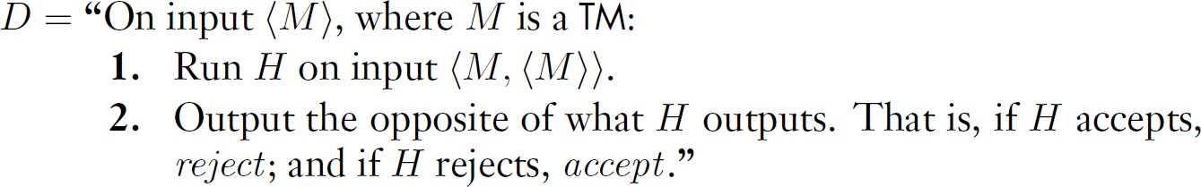
Acceptance Problem is Recognizable but Undecidable
A_{TM} = { M, w : M is a Turing machine that accepts the string w}
Theorem
A_{TM} is Turing-recognizable but not decidable.
Proof idea:
UTM can simulate M on w, so it is Turing-recognizable. If a decider H exists:
D is paradoxical.

Slide 30
Unrecognizable Languages
Theorem
A language A is decidable if and only if it is Turing-recognizable and co-Turing- recognizable.
Proof idea:
One direction is easy.
Assume recognizable and co-recognizable, we simulate two recognizable in parallel to form a decider.
Corollary A_{TM} is not Turing-recognizable.

Slide 31
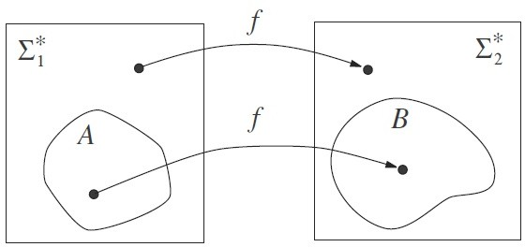
Mapping Reduction
w ∈ A ⇐⇒ f(w) ∈ B
We write A is mapping reducible to B as A ≤_{m} B
31

Slide 32
Mapping Reducibility and Halting Problem
Theorems
If A ≤_{m} B and B is decidable, then A is decidable.
If A ≤_{m} B and A is undecidable, then B is undecidable also.
If A ≤_{m} B and B is Turing-recognizable, then A is Turing-recognizable.
If A ≤_{m} B and A is not Turing-recognizable, then B is not Turing-recognizable also.
H_{TM} = { M, w : M is a Turing machine that halts on the string w}
Theorem
H_{TM} is Turing-recognizable but not decidable.
Proof idea:
Reduce undecidable A_{TM} to H_{TM} shows H_{TM} is undecidable.

Slide 33
Non-trivial Properties and Rice’s Theorem
• | 𝐸_{𝑇𝑀} = {< 𝑀 > | 𝑀 𝑖𝑠 𝑎 𝑇𝑀 𝑎𝑛𝑑 𝐿(𝑀) = ∅}.
• | 𝐼𝑁𝐹𝐼𝑁𝐼𝑇𝐸_{𝑇𝑀} = < 𝑀 > 𝑀 𝑖𝑠 𝑎 𝑇𝑀 𝑎𝑛𝑑 𝐿 𝑀 = ∞}.
• | 𝐿𝑇_{𝑇𝑀} = < 𝑀 > 𝑀 𝑖𝑠 𝑎 𝑇𝑀 𝑎𝑛𝑑 𝐿 𝑀 = 𝐿 𝑇 }.
• | 𝐹𝐼𝑁𝐼𝑇𝐸_{𝑇𝑀} = < 𝑀 > 𝑀 𝑖𝑠 𝑎 𝑇𝑀 𝑎𝑛𝑑 ∃𝑛 ∈ 𝑁, 𝐿 𝑀 = 𝑛}.
• | 𝐴𝐿𝐿_{𝑇𝑀} = < 𝑀 > 𝑀 𝑖𝑠 𝑎 𝑇𝑀 𝑎𝑛𝑑 𝐿 𝑀 = Σ∗}
Turing machine descriptions of non-trivial properties P :
none empty set. i.e., 𝑃 ≠ ∅
none of them includes all Turing machines . i.e., 𝑃 ≠ {< 𝑀 > | 𝑀 𝑖𝑠 𝑎 𝑇𝑀}
<M> is accepted iff L(M) satisfy some properties,
i.e., P= < 𝑀 > 𝑀 𝑖𝑠 𝑎 𝑇𝑀 𝑎𝑛𝑑 𝐿 𝑀 ∈ 𝐿𝑃 ⊂ 𝑃𝑜𝑤𝑒𝑟(Σ∗)} .
Rice’s Theorem
Any non-trivial property of Turing machines is undecidable
33

Slide 34
Rice’s Theorem and Applications
Let P be a subset of Turing machine descriptions such that
1. P ≠ ∅,
P is a proper subset of Turing machine descriptions ,
for any two Turing machines M₁ and M₂ with L(M₁) = L(M₂),
either both M₁ and M₂ are in P or
none of M₁ and M₂ is in P.
𝐼𝑁𝐹𝐼𝑁𝐼𝑇𝐸_{𝑇𝑀} = < 𝑀 > 𝑀 𝑖𝑠 𝑎 𝑇𝑀 𝑎𝑛𝑑 𝐿 𝑀 = ∞}.
A TM accepts all inputs is in the set.
A TM rejects all inputs is not in the set.
If L(M₁) = L(M₂), |L(M₁)| = |L(M₂)| so they are both either infinite or finite, either both in the set or not in the set respectively.
Therefore 𝐼𝑁𝐹𝐼𝑁𝐼𝑇𝐸_{𝑇𝑀} is undecidable by Rice’s theorem
34

Slide 35
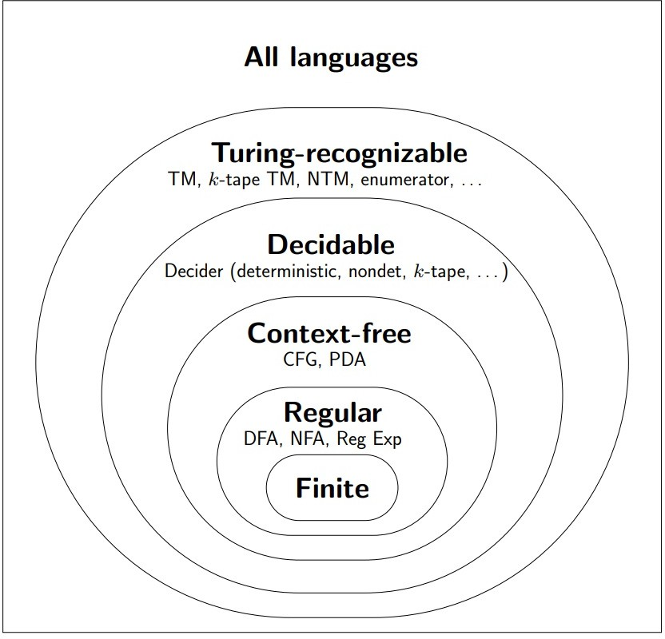
Language Hierarchy
Except enumerator (check Sipser), you need to know them all.
You need to know their closure properties.
You need to know examples that distinguish the circles.
You need to know theorems that allow you to distinguish the circles.

Slide 36
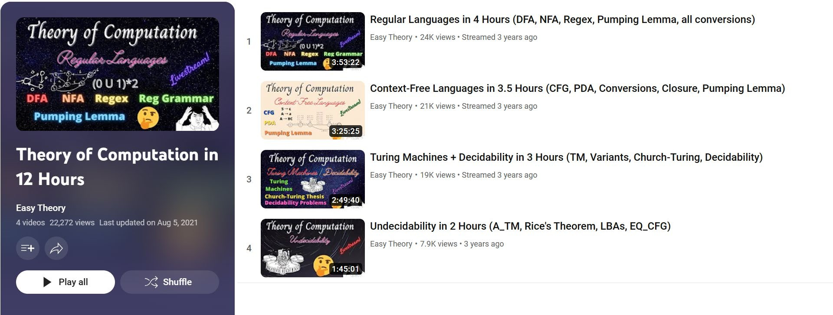
Highly Recommended Revision Resources
Theory of Computation in 12 Hours at Easy Theory YouTube Channel
Email me at chunchuan.lyu@xjtlu.edu.cn at any time TAs will be here for QA Thursday.

Slide 37




THANK YOU

